Slide 1
Modern Programming Languages
UIIT PMAS Arid Agriculture University, Rawalpindi
Course Instructor: Suleman Khurram

Slide 2
Aim of the course
Apparent:
Developing a practical knowledge of Programming
JAVA, the language
JAVA Web development
Modern Web frameworks
Furthermore:
Refine your understanding of OOP
Learn how to learn another programming language
Be a better programmer in general (hopefully!)

Slide 3
Distribution - Tentative
Grades breakdown: according to UIIT rules
Assignments and Quizzes
Midterm and Final
Project details will be out at the halfway mark
Groups of 3-4
Propose a project idea, write a brief specification
Implement it and present to the class

Slide 4
Recommended Books
Introduction to Java Programming (Y. Daniel Liang, Armstrong State University, Georgia Southern University)
Java: The Complete Reference, J2SE 5 Edition 6th Edition (Herbert Schildt)
Beginning Java 2 by Ivor Horton
Teach Yourself Java in 21 Days, Sams Series
Designing Object Oriented Software by Rebecca WirfsBrock, Brian Wilkerson, Lauren Wiener (For OOP)

Slide 5
JAVA

Slide 6
JAVA
Java is a high-level, class-based, object-oriented programming language first released by Sun Microsystems in 1995.
Compiled Java code can run on all platforms that support Java without the need for recompilation.
Java was originally developed by James Gosling at Sun Microsystems.
Oracle offers its own HotSpot Java Virtual Machine, however OpenJDK JVM is free open-source software and used by most developers and is the default JVM for almost all Linux distributions.

Slide 7
JAVA History
James Gosling, Mike Sheridan, and Patrick Naughton initiated the Java language project in June 1991. The small team of sun engineers called Green Team.
Firstly, it was called "Greentalk" by James Gosling, and the file extension was .gt.
After that, it was called Oak and was developed as a part of the Green project.
According to James Gosling, "Java was one of the top choices". Since Java was so unique, most of the team members preferred Java than other names.
https://www.javatpoint.com/history-of-java

Slide 8
Why Java?
The answer is that Java enables users to develop and deploy applications on the Internet for servers, desktop computers, and small hand-held devices. The future of computing is being profoundly influenced by the Internet, and Java promises to remain a big part of that future. Java is the Internet programming language.
Java is a general purpose programming language.
Java is the Internet programming language.

Slide 9
Java, Web, and Beyond
Java can be used to develop standalone applications.
Java can be used to develop applications running from a browser.
Java can also be used to develop applications for hand-held devices.
Java can be used to develop applications for Web servers.

Slide 10
JDK Versions
JDK 1.02 (1995)
JDK 1.1 (1996)
JDK 1.2 (1998)
JDK 1.3 (2000)
JDK 1.4 (2002)
JDK 1.5 (2004) a. k. a. JDK 5 or Java 5
JDK 1.6 (2006) a. k. a. JDK 6 or Java 6
JDK 1.7 (2011) a. k. a. JDK 7 or Java 7
JDK 1.8 (2014) a. k. a. JDK 8 or Java 8
.
.
.
JDK 16 (2021)

Slide 11
JDK Editions
Java Standard Edition (J2SE)
J2SE can be used to develop client-side standalone applications or applets.
Java Enterprise Edition (J2EE)
J2EE can be used to develop server-side applications such as Java servlets, Java ServerPages, and Java ServerFaces.
Java Micro Edition (J2ME).
J2ME can be used to develop applications for mobile devices such as cell phones.

Slide 12
Characteristics of Java (Java buzzwords)
Java Is Simple
Java Is Object-Oriented
Java Is Distributed
Java Is Interpreted
Java Is Robust
Java Is Secure
Java Is Architecture-Neutral
Java Is Portable
Java's Performance
Java Is Multithreaded
Java Is Dynamic
www.cs.armstrong.edu/liang/JavaCharacteristics.pdf

Slide 13
Characteristics of Java
Java Is Simple
Java Is Object-Oriented
Java Is Distributed
Java Is Interpreted
Java Is Robust
Java Is Secure
Java Is Architecture-Neutral
Java Is Portable
Java's Performance
Java Is Multithreaded
Java Is Dynamic
Java is partially modeled on C++, but greatly simplified and improved. Some people refer to Java as "C++--" because it is like C++ but with more functionality and fewer negative aspects.

Slide 14
Characteristics of Java
Java Is Simple
Java Is Object-Oriented
Java Is Distributed
Java Is Interpreted
Java Is Robust
Java Is Secure
Java Is Architecture-Neutral
Java Is Portable
Java's Performance
Java Is Multithreaded
Java Is Dynamic
Java is inherently object-oriented. Although many object-oriented languages began strictly as procedural languages, Java was designed from the start to be object-oriented. Object-oriented programming (OOP) is a popular programming approach that is replacing traditional procedural programming techniques.
One of the central issues in software development is how to reuse code. Object-oriented programming provides great flexibility, modularity, clarity, and reusability through encapsulation, inheritance, and polymorphism.

Slide 15
Characteristics of Java
Java Is Simple
Java Is Object-Oriented
Java Is Distributed
Java Is Interpreted
Java Is Robust
Java Is Secure
Java Is Architecture-Neutral
Java Is Portable
Java's Performance
Java Is Multithreaded
Java Is Dynamic
Distributed computing involves several computers working together on a network. Java is designed to make distributed computing easy. Since networking capability is inherently integrated into Java, writing network programs is like sending and receiving data to and from a file.

Slide 16
Characteristics of Java
Java Is Simple
Java Is Object-Oriented
Java Is Distributed
Java Is Interpreted
Java Is Robust
Java Is Secure
Java Is Architecture-Neutral
Java Is Portable
Java's Performance
Java Is Multithreaded
Java Is Dynamic
You need an interpreter to run Java programs. The programs are compiled into the Java Virtual Machine code called bytecode. The bytecode is machine-independent and can run on any machine that has a Java interpreter, which is part of the Java Virtual Machine (JVM).

Slide 17
Characteristics of Java
Java Is Simple
Java Is Object-Oriented
Java Is Distributed
Java Is Interpreted
Java Is Robust
Java Is Secure
Java Is Architecture-Neutral
Java Is Portable
Java's Performance
Java Is Multithreaded
Java Is Dynamic
Java compilers can detect many problems that would first show up at execution time in other languages.
Java has eliminated certain types of error-prone programming constructs found in other languages.
Java has a runtime exception-handling feature to provide programming support for robustness.

Slide 18
Characteristics of Java
Java Is Simple
Java Is Object-Oriented
Java Is Distributed
Java Is Interpreted
Java Is Robust
Java Is Secure
Java Is Architecture-Neutral
Java Is Portable
Java's Performance
Java Is Multithreaded
Java Is Dynamic
Java implements several security mechanisms to protect your system against harm caused by stray programs.

Slide 19
Characteristics of Java
Java Is Simple
Java Is Object-Oriented
Java Is Distributed
Java Is Interpreted
Java Is Robust
Java Is Secure
Java Is Architecture-Neutral
Java Is Portable
Java's Performance
Java Is Multithreaded
Java Is Dynamic
Write once, run anywhere
With a Java Virtual Machine (JVM), you can write one program that will run on any platform.

Slide 20
Characteristics of Java
Java Is Simple
Java Is Object-Oriented
Java Is Distributed
Java Is Interpreted
Java Is Robust
Java Is Secure
Java Is Architecture-Neutral
Java Is Portable
Java's Performance
Java Is Multithreaded
Java Is Dynamic
Because Java is architecture neutral, Java programs are portable. They can be run on any platform without being recompiled.

Slide 21
Characteristics of Java
Java Is Simple
Java Is Object-Oriented
Java Is Distributed
Java Is Interpreted
Java Is Robust
Java Is Secure
Java Is Architecture-Neutral
Java Is Portable
Java's Performance
Java Is Multithreaded
Java Is Dynamic
Java’s performance Because Java is architecture neutral, Java programs are portable. They can be run on any platform without being recompiled.

Slide 22
Characteristics of Java
Java Is Simple
Java Is Object-Oriented
Java Is Distributed
Java Is Interpreted
Java Is Robust
Java Is Secure
Java Is Architecture-Neutral
Java Is Portable
Java's Performance
Java Is Multithreaded
Java Is Dynamic
Multithread programming is smoothly integrated in Java, whereas in other languages you have to call procedures specific to the operating system to enable multithreading.

Slide 23
Characteristics of Java
Java Is Simple
Java Is Object-Oriented
Java Is Distributed
Java Is Interpreted
Java Is Robust
Java Is Secure
Java Is Architecture-Neutral
Java Is Portable
Java's Performance
Java Is Multithreaded
Java Is Dynamic
Java was designed to adapt to an evolving environment. New code can be loaded on the fly without recompilation. There is no need for developers to create, and for users to install, major new software versions. New features can be incorporated transparently as needed.

Slide 24
C++ vs Java
Comparison Index | C++ | Java
Platform-independent | C++ is platform-dependent. | Java is platform-independent.
Mainly used for | C++ is mainly used for system programming. | Java is mainly used for application programming. It is widely used in Windows-based, web-based, enterprise, and mobile applications.
Goto | C++ supports the goto statement. | Java doesn't support the goto statement.
Multiple inheritance | C++ supports multiple inheritance. | Java doesn't support multiple inheritance through class. It can be achieved by using interfaces in java.
Pointers | C++ supports pointers. You can write a pointer program in C++. | Java supports pointer internally. However, you can't write the pointer program in java. It means java has restricted pointer support in java.

Slide 25
C++ vs Java
Comparison Index | C++ | Java
Call by Value and Call by reference | C++ supports both call by value and call by reference. | Java supports call by value only. There is no call by reference in java.
Documentation comment | C++ doesn't support documentation comments. | Java supports documentation comment (/** ... */) to create documentation for java source code.
Hardware | C++ is nearer to hardware. | Java is not so interactive with hardware.
Object-oriented | C++ is an object-oriented language. However, in the C language, a single root hierarchy is not possible. | Java is also an object-oriented language. However, everything (except fundamental types) is an object in Java. It is a single root hierarchy as everything gets derived from java.lang.Object.

Slide 26
C# vs Java
C# | Java
C# is an object-oriented programming language developed by Microsoft that runs on .Net Framework. | Java is a high level, robust, secured and object-oriented programming language developed by Oracle.
C# programming language is designed to be run on the Common Language Runtime (CLR). | Java programming language is designed to be run on a Java platform, by the help of Java Runtime Environment (JRE).
In C#, built-in data types that are passed by value are called simple types. | In java, built-in data types that are passed by value are called primitive types.
C# supports goto statement. | Java doesn't support goto statement.
https://hackr.io/blog/c-sharp-vs-java
https://www.javatpoint.com/java-vs-csharp

Slide 27
How to install JDK
https://www.youtube.com/watch?v=IJ-PJbvJBGs
https://www.guru99.com/install-java.html

Slide 28
Popular Java IDEs (Integrated Development Environments)
NetBeans
Eclipse
Simple applications can also be made using Notepad without any IDE.

Slide 29
A Simple Java Program
// This program prints Welcome to Java!
public class Welcome {
public static void main(String[] args) {
System.out.println("Welcome to Java!");
}
}

Slide 30

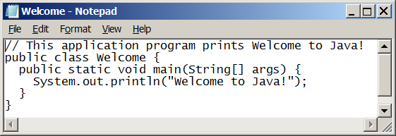
Creating and Editing Using NotePad
To use NotePad, type notepad Welcome.java from the DOS prompt.

Slide 31
Simple steps to run JAVA Program
https://www.javatpoint.com/how-to-run-java-program-in-cmd-using-notepad

Slide 32
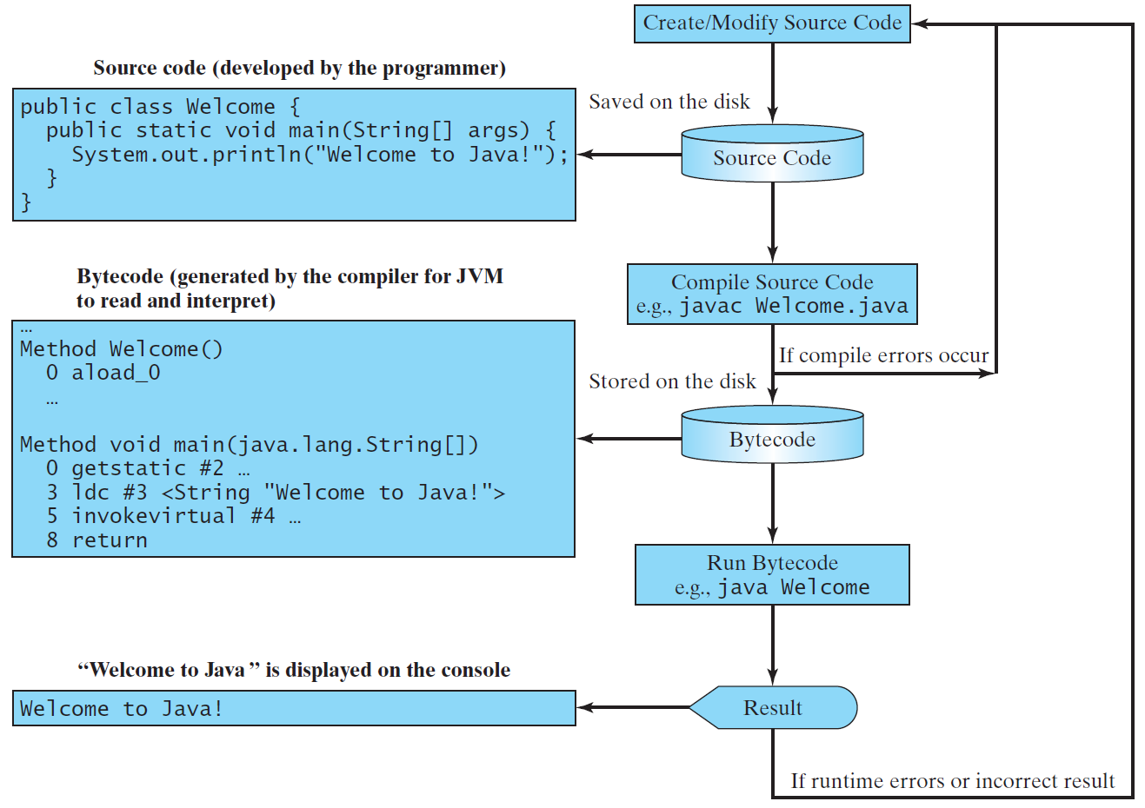
Creating, Compiling, and Running Programs

Slide 33
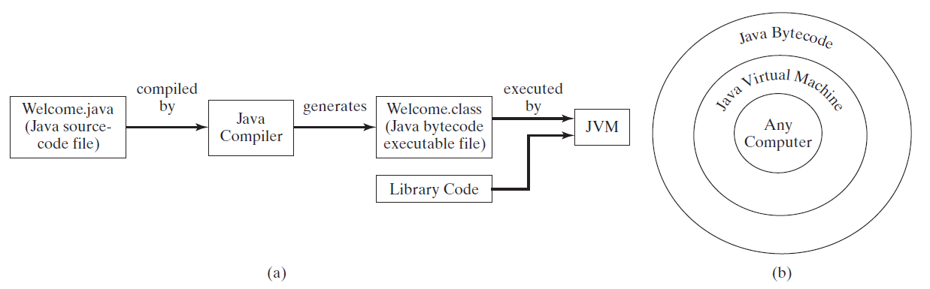
Compiling Java Source Code
You can port a source program to any machine with appropriate compilers. The source program must be recompiled, however, because the object program can only run on a specific machine. Nowadays computers are networked to work together. Java was designed to run object programs on any platform. With Java, you write the program once, and compile the source program into a special type of object code, known as bytecode. The bytecode can then run on any computer with a Java Virtual Machine, as shown below. Java Virtual Machine is a software that interprets Java bytecode.

Slide 34
Trace a Program Execution
Enter main method
// This program prints Welcome to Java!
public class Welcome {
public static void main(String[] args) {
System.out.println("Welcome to Java!");
}
}

Slide 35
Trace a Program Execution
Execute statement
// This program prints Welcome to Java!
public class Welcome {
public static void main(String[] args) {
System.out.println("Welcome to Java!");
}
}

Slide 36
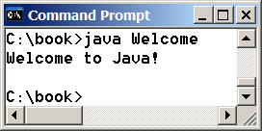
Trace a Program Execution
// This program prints Welcome to Java!
public class Welcome {
public static void main(String[] args) {
System.out.println("Welcome to Java!");
}
}
print a message to the console

Slide 37
Anatomy of a Java Program
Class name
Main method
Statements
Statement terminator
Reserved words
Comments
Blocks

Slide 38
Class Name
Every Java program must have at least one class. Each class has a name. By convention, class names start with an uppercase letter. In this example, the class name is Welcome.
// This program prints Welcome to Java!
public class Welcome {
public static void main(String[] args) {
System.out.println("Welcome to Java!");
}
}

Slide 39
Main Method
Line 2 defines the main method. In order to run a class, the class must contain a method named main. The program is executed from the main method.
// This program prints Welcome to Java!
public class Welcome {
public static void main(String[] args) {
System.out.println("Welcome to Java!");
}
}

Slide 40
Statement
A statement represents an action or a sequence of actions. The statement System.out.println("Welcome to Java!") in the program in Listing 1.1 is a statement to display the greeting "Welcome to Java!“.
// This program prints Welcome to Java!
public class Welcome {
public static void main(String[] args) {
System.out.println("Welcome to Java!");
}
}

Slide 41
Statement Terminator
Every statement in Java ends with a semicolon (;).
// This program prints Welcome to Java!
public class Welcome {
public static void main(String[] args) {
System.out.println("Welcome to Java!");
}
}

Slide 42
Reserved words
Reserved words or keywords are words that have a specific meaning to the compiler and cannot be used for other purposes in the program. For example, when the compiler sees the word class, it understands that the word after class is the name for the class.
// This program prints Welcome to Java!
public class Welcome {
public static void main(String[] args) {
System.out.println("Welcome to Java!");
}
}

Slide 43
Blocks
A pair of braces in a program forms a block that groups components of a program.

Slide 44
Special Symbols

Slide 45
{ … }
// This program prints Welcome to Java!
public class Welcome {
public static void main(String[] args) {
System.out.println("Welcome to Java!");
}
}

Slide 46
( … )
// This program prints Welcome to Java!
public class Welcome {
public static void main(String[] args) {
System.out.println("Welcome to Java!");
}
}

Slide 47
;
// This program prints Welcome to Java!
public class Welcome {
public static void main(String[] args) {
System.out.println("Welcome to Java!");
}
}

Slide 48
// …
// This program prints Welcome to Java!
public class Welcome {
public static void main(String[] args) {
System.out.println("Welcome to Java!");
}
}

Slide 49
" … "
// This program prints Welcome to Java!
public class Welcome {
public static void main(String[] args) {
System.out.println("Welcome to Java!");
}
}

Slide 50
Programming Style and Documentation
Appropriate Comments
Naming Conventions
Proper Indentation and Spacing Lines
Block Styles

Slide 51
Appropriate Comments
Include a summary at the beginning of the program to explain what the program does, its key features, its supporting data structures, and any unique techniques it uses.
Include your name, class section, instructor, date, and a brief description at the beginning of the program.

Slide 52
Naming Conventions
Choose meaningful and descriptive names.
Class names:
Capitalize the first letter of each word in the name. For example, the class name ComputeExpression.

Slide 53
Proper Indentation and Spacing
Indentation
Indent two spaces.
Spacing
Use blank line to separate segments of the code.

Slide 54
Block Styles
Use end-of-line style for braces.

Slide 55
JAVA Command Line Arguments
public class CommandLineExample{
public static void main(String args[]){
System.out.println("Your first argument is: "+args[0]);
}
}
javac CommandLineExample.java
java CommandLineExample suleman
Output: Your first argument is: suleman

Slide 56
Programming Errors
Syntax Errors
Detected by the compiler
Runtime Errors
Causes the program to abort
Logic Errors
Produces incorrect result

Slide 57
Syntax Errors
public class ShowSyntaxErrors {
public static main(String[] args) {
System.out.println("Welcome to Java);
}
}

Slide 58
Runtime Errors
public class ShowRuntimeErrors {
public static void main(String[] args) {
System.out.println(1 / 0);
}
}

Slide 59
Logic Errors
public class ShowLogicErrors {
public static void main(String[] args) {
System.out.print("Celsius 35 is ");
System.out.print("Fahrenheit ");
System.out.println((9 / 5) * 35 + 32);
}
}

